Slide 1
Fast Track to F#
Data and type providers

Slide 2
data acquisition statistics data cleaning machine learning data transformation visualization type providers
F# Data Science Working Group
kaggle vega grammar data sources presentation
R provider visualization
www.fslab.org
time-series data aggregation

Slide 3

www.fslab.org

Slide 4


F# Data type providers
First-class data
CSV, REST, WorldBank…
R Type provider
Statistics & visualization
5000 tested packages
www.fslab.org

Slide 5


Deedle data frame
Data exploration
Indexing and aggregation
F# Charting library
Simple & composable
Interactive style
www.fslab.org

Slide 6
F# Data
http://fsharp.github.io/FSharp.Data/

Slide 7
The confusion of languages

Slide 8
Bridging the mismatch
Dynamic operator and generics
Specifies expected structure locally
Domain model using F# or C#
Define structure using types (auto generated)
Load data into the structure
Type providers in F# 3.0
Generate types representing the data (on demand)

Slide 9
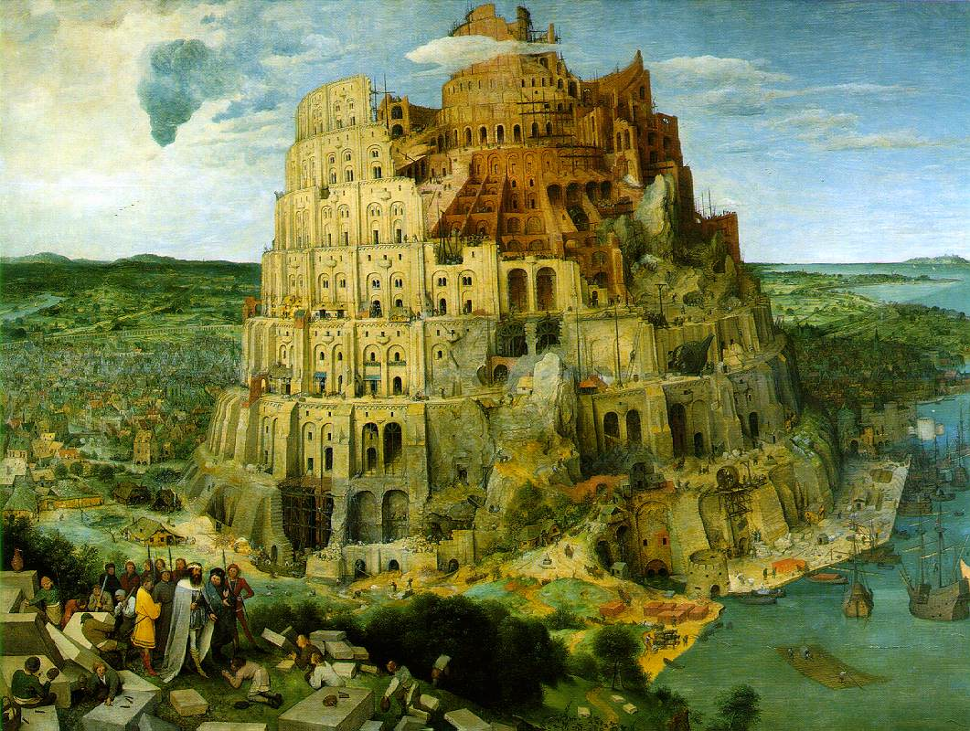
The confusion of languages

Slide 10
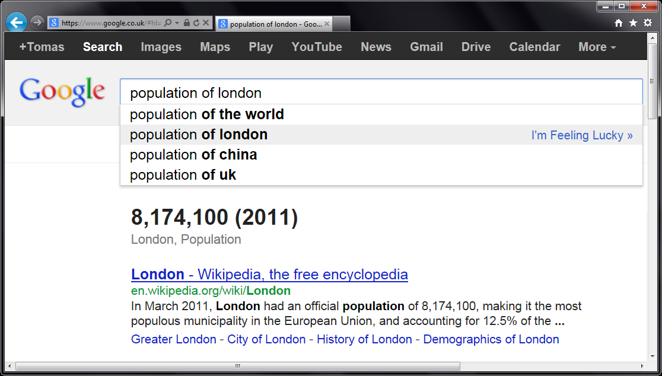


Slide 11
let wb = WorldBank() wb.

Slide 12
DEMO WorldBank type provider

Slide 13
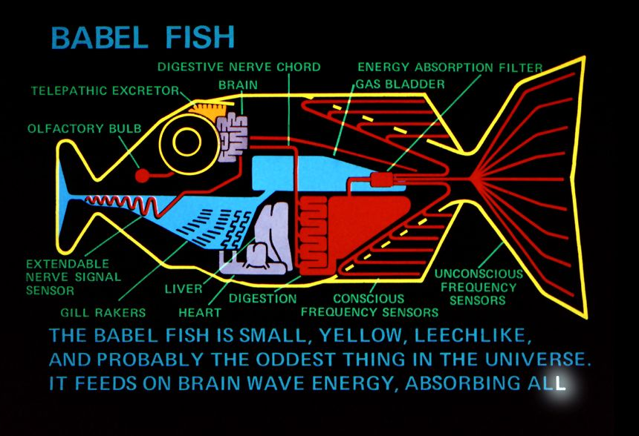
What is a Type Provider?

Slide 14
How are Type Providers used?
Compiler
Type-Check Imported Types
Compile using Type Provider
Type provider
IDE
IntelliSense for Generated Types

Slide 15
TASKS Analyzing data

Slide 16
Accessing SQL databases
LINQ Type providers
Included with standard F#
LINQ to SQL and LINQ to Entities
SQL Type provider
Flexible open-source; supports Oracle, Postgress, etc.
http://fsprojects.github.io/SQLProvider
SQL Client provider
Statically checked SQL commands
http://fsprojects.github.io/FSharp.Data.SqlClient

Slide 17
Other type providers
Community projects
Web: Apiary.io and OData providers
Cloud: Azure and Amazon S3
Enterprise: Dynamics NAV and CRM
Finance: Xenomorph TimeScape provider
See F# Foundation for more
http://fsharp.org/data-access

Slide 18

Deedle
http://bluemountaincapital.github.io/Deedle/

Slide 19
Deedle is for…
(Exploratory) Data Analysis
Time-Series Analysis
Data Processing / Transformation
Data Cleaning
Statistics and Visualization, via other packages

Slide 20
Deedle is…
Third iteration
Easy-to-use from C# and F#
Well documented
Open Source
Ready for you to contribute

Slide 21
Deedle Concepts
Series
Key->Value mapping
Key is often date/time
Immutable
Supports missing values
LINQ-friendly

Slide 22
Deedle Concepts
Frame
(RowKey, ColKey)->Value
RowKey is often date/time
ColKey is often string
Heterogeneous Values
Column-wise mutable
Data alignment
Hierarchical indexing

Slide 23
DEMO Deedle

